Slide 1
BadgeOverview.html
Author:
Nathan Martz
Team Members:
Ryan Schroder
Michael Glosecki
Matt Eck

Slide 2
Overview
Major Requirements
Organizes badges by rank
Will display badge requirements
Implementation Languages
HTML
Pre-compiled Bootstrap functions
Development Time
About 12 person hours with some hangups
Core Functionality
This web interface will organize and display badges by rank and display the badge requirements

Slide 3
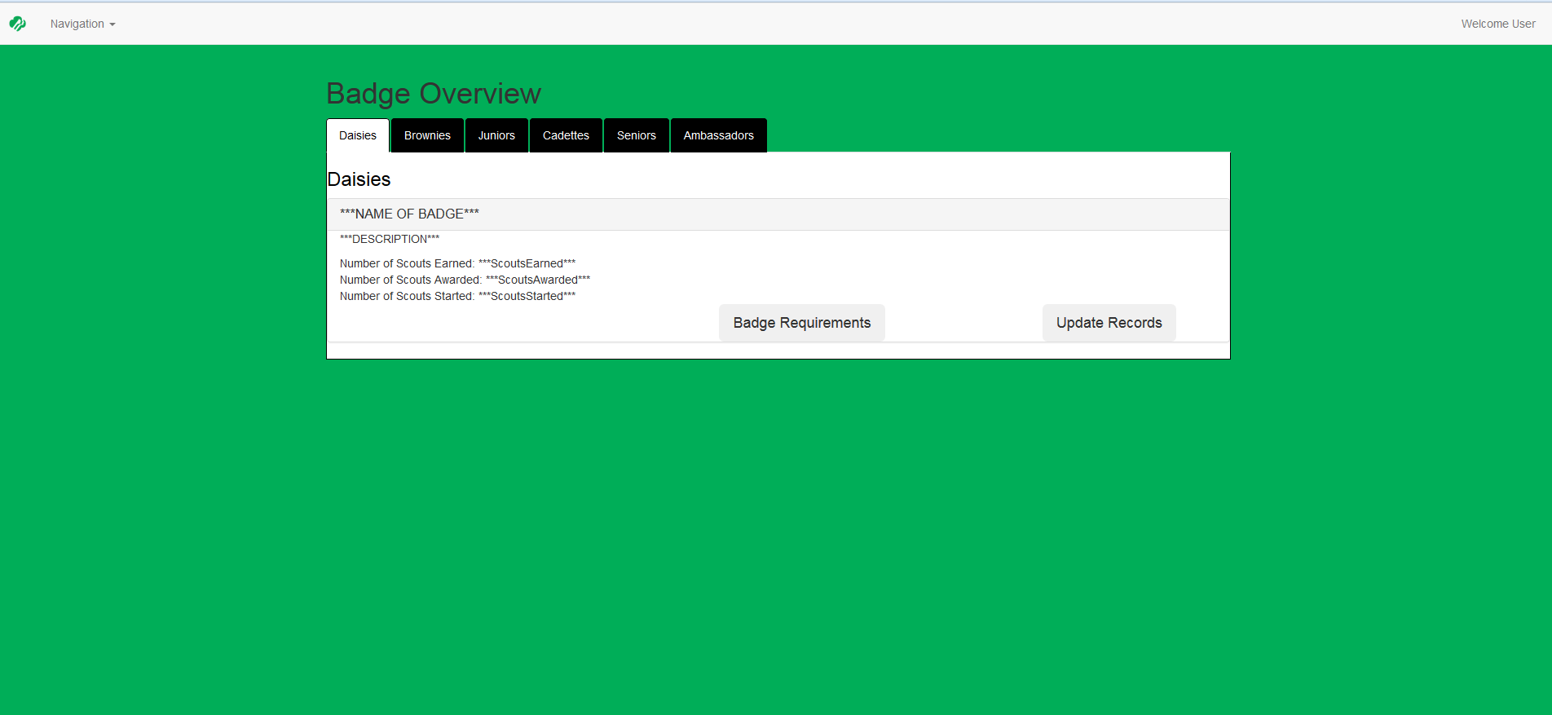

Slide 4
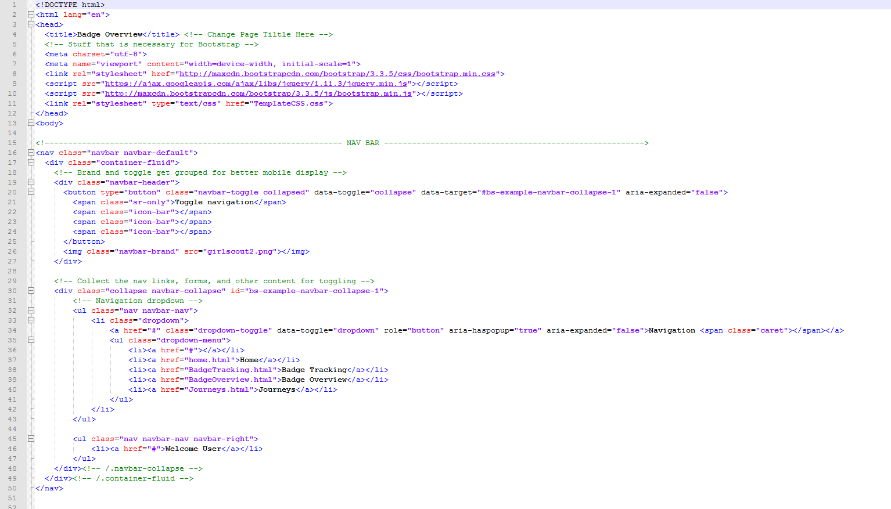

Slide 5
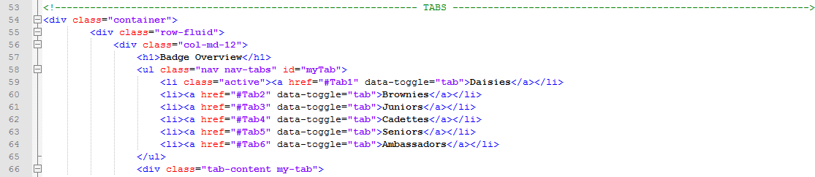

Slide 6
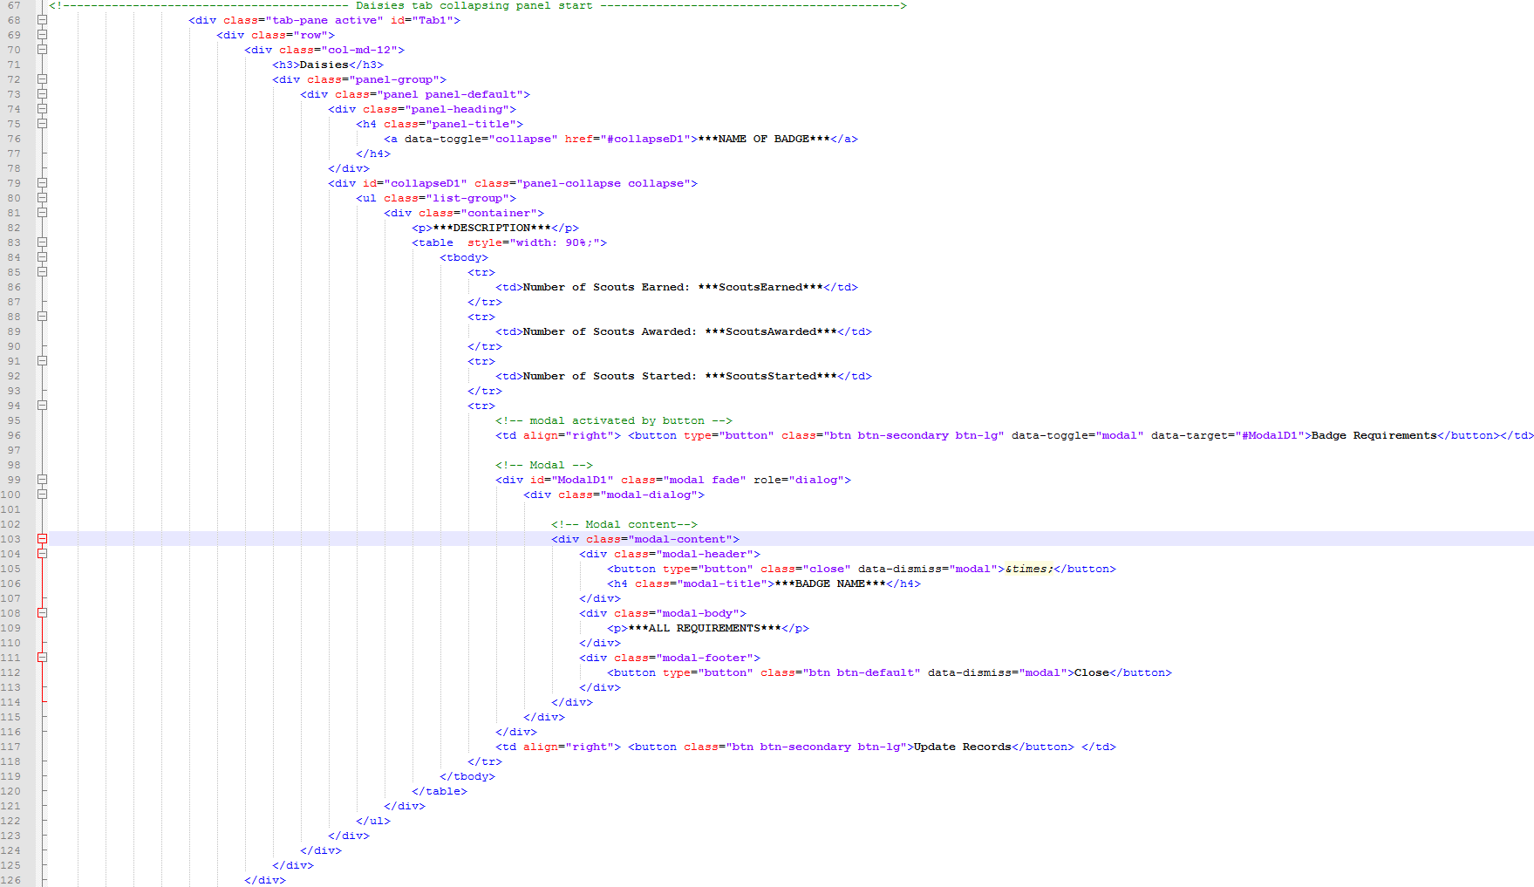

Slide 7
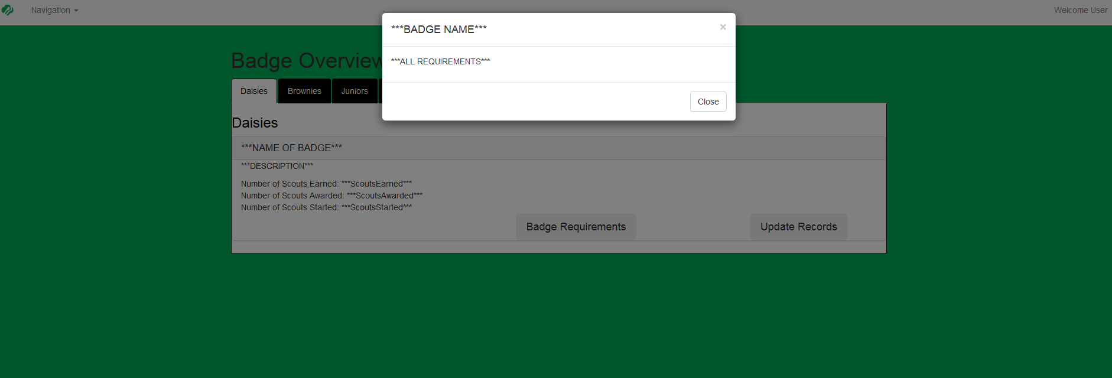

Slide 8
TemplateCSS.css
Author:
Nathan Martz and Matt Eck
Team Members:
Ryan Schroder
Michael Glosecki
Matt Eck

Slide 9
